Slide 1


Data Science module IV

Slide 2
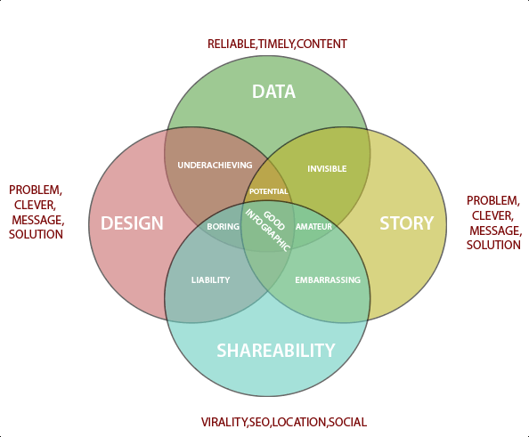
Data Visualization

Slide 3
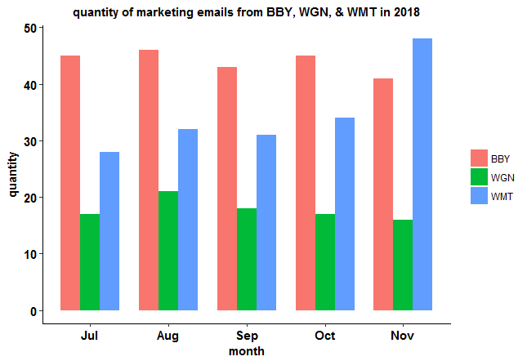
Data Visualization

Slide 4
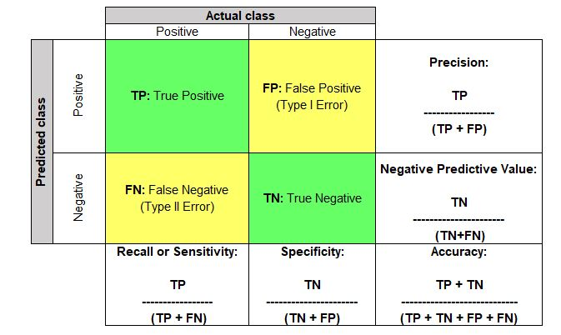
Evaluation

Slide 5
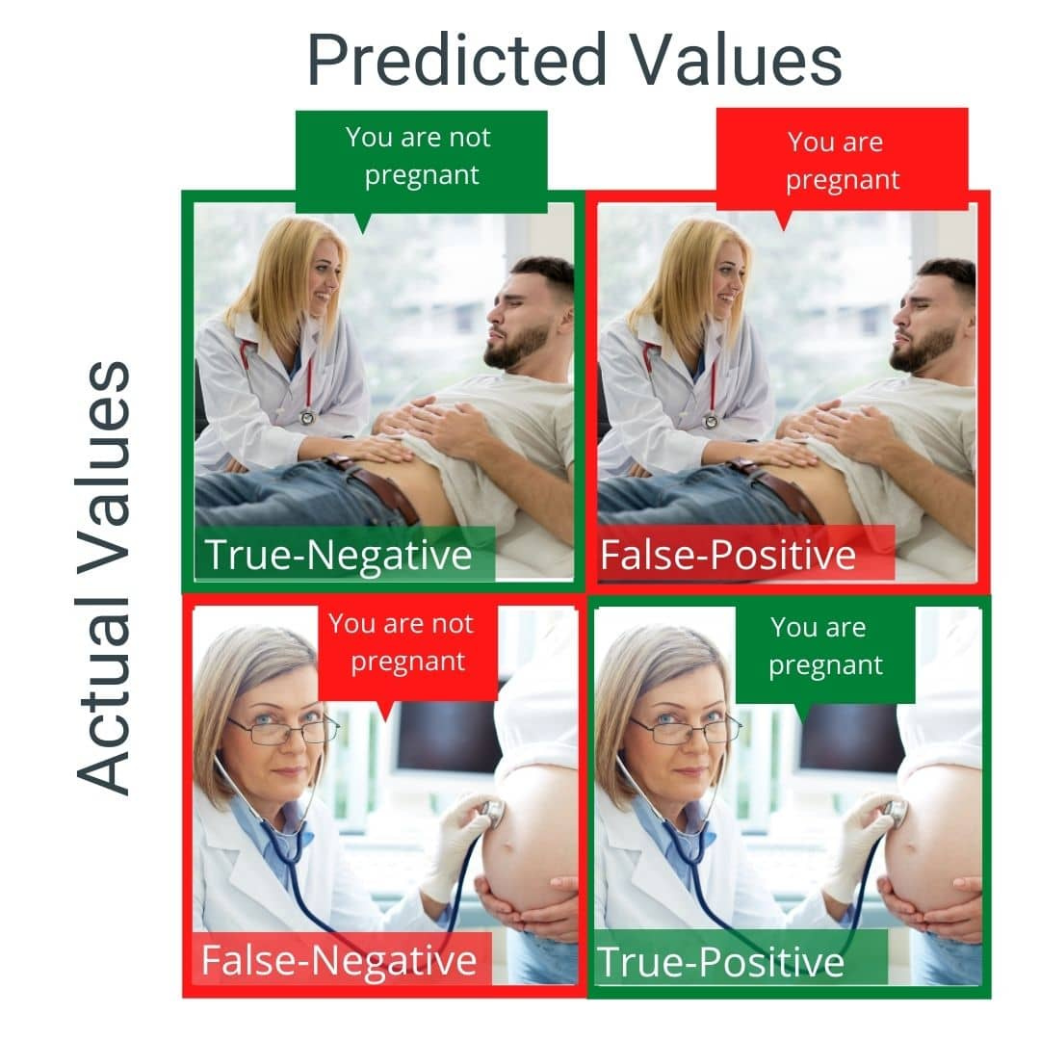
Model evaluation

Slide 6
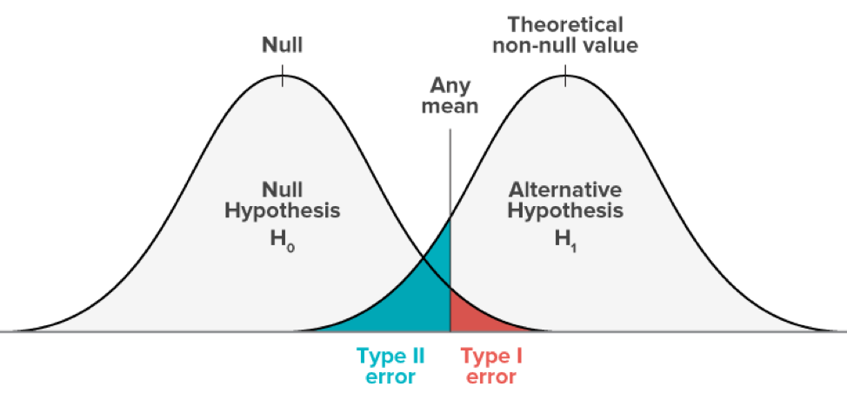
Model Evaluation

Slide 7
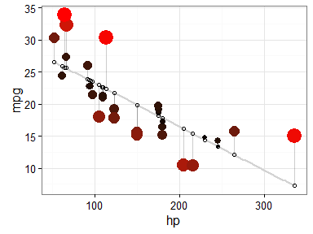
Residual Plot

Slide 8
Distribution plot

Slide 9
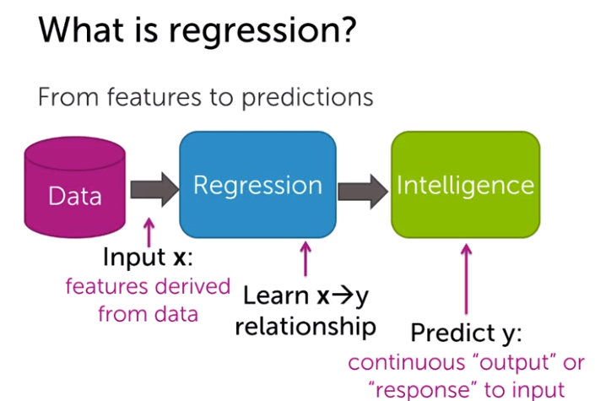
Regression

Slide 10
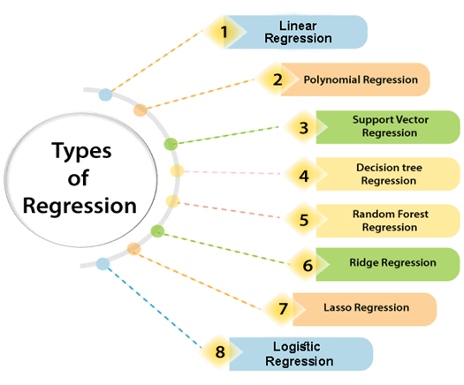
Regression

Slide 11
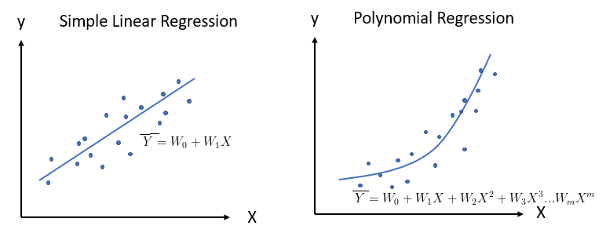
Simple vs Polynomial Regression

Slide 12
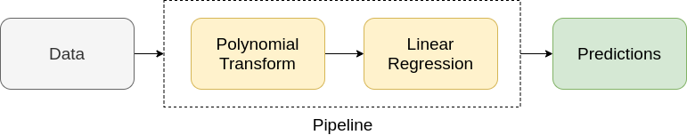
Pipelines

Slide 13
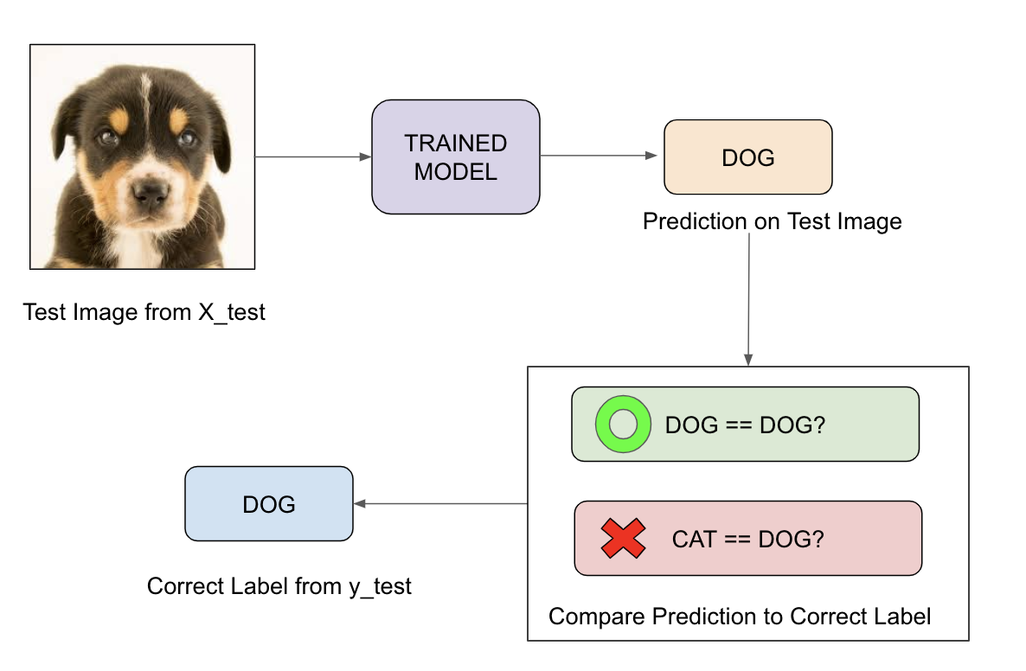
In-Sample Evaluation

Slide 14
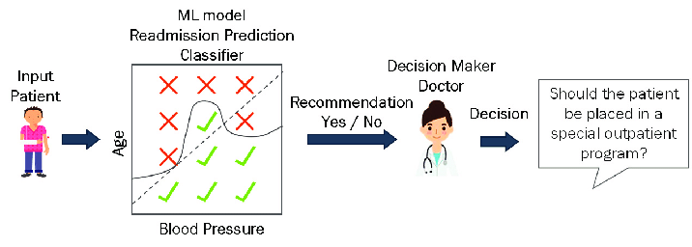
Prediction Decision Making

